Slide 1


Introduction to the Portuguese Bank Case
Wake Forest
School of Business
_______
BAN 6025

Slide 2
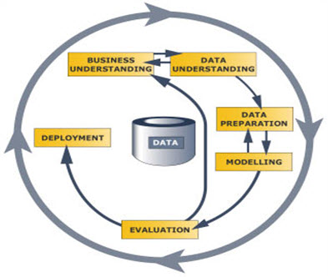


Predictive Modeling Process
CRISP-DM
Cross-Industry Standard Process for Data Mining
Business Understanding
Data Understanding
Data Preparation
Modeling
Evaluation
Deployment
SEMMA
SAS Model Building Framework
Sample
Explore
Modify
Model
Assess

Slide 3
Portuguese Bank Data
Variable Name | Variable Description | Measurement Level
Economic Conditions
CCI | Consumer confidence index (monthly) | Interval
CPI | Consumer price index (monthly) | Interval
EMPVAR | Employment variation rate (quarterly) | Interval
EURIBOR3M | 3 month interest rate (daily) | Interval
NREMP | Number of people employed (quarterly) | Interval
Demographic Information
AGE | Age of customer | Interval
DEFAULT | Has credit in default? (yes, no, unknown) | Nominal
EDUCATION | Customer’s education level | Nominal
HOUSING | Has housing loan? (yes, no, unknown) | Nominal

Slide 4
Portuguese Bank Data
Variable Name | Variable Description | Measurement Level
Demographic Information (cont)
JOB | Type of job held by customer | Nominal
LOAN | Has personal loan? (no, yes, unknown) | Nominal
MARITAL | Marital status | Nominal
Marketing Contact History
MONTH | Month of last contact with customer | Nominal
PDAYS | # days since customer was last contacted from a previous campaign | Interval
POUTCOME | Outcome of the previous marketing campaign (failure, nonexistent, success) | Nominal
PREVIOUS | # of contacts performed for this customer before this campaign | Interval
RESPOND | Did the client respond positively and accept the offer? (yes, no) | Binary

Slide 5
Portuguese Bank Data
Variable Name | Variable Description | Measurement Level
Marketing Campaign History (cont)
CAMPAIGN | # contacts performed during this campaign for this customer | Interval
CONTACT | Contact communication type (cellular, telephone) | Binary
DOW | Day of the week last contact was made | Nominal
DURATION | Duration of last contact (in seconds) | Interval

Slide 6
Goal
Build a predictive model to help the bank determine which customers are most likely to respond to a similar marketing campaign in the future so that:
The bank can understand the characteristics of customers who are most likely to respond positively to future marketing campaigns
The bank can operate more efficiently by focusing their marketing efforts on customers who are most likely to respond positively
The bank can take actions to help improve the response rate for future marketing campaigns

Slide 7
Update Variable List
Do you believe that we should use DURATION as one of the predictive variables when creating a model to predict who is likely to respond positively to this marketing campaign?

Slide 8
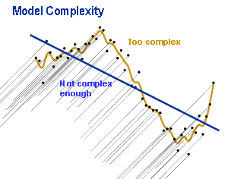
Partition the Data
A good predictive model should generalize well to new data

Slide 9
Partition the Data
Data Partitioning splits the data into training and validation sets
Training data is used for “fitting the model” (e.g., estimating the coefficients)
Test data is used for monitoring and tuning the model to improve its ability to generalize
In particular, when choosing among a set of competing predictive models, the performance of the model on the validation data set (in terms of fit statistics or misclassification rates) is used to choose the final model. In other words, the model that performs “best” on the validation data set is the winner.
NOTE: The use of data partitioning is not recommended for small data sets.

